Slide 1

DATA ANALYTIC
Prof. Imran Khan
INSIGHTS INTO INCIDENT PATTERNS WITH A FOCUS ON BROOKLYN
NYC SCHOOL BUS BREAKDOWN AND DELAYS ANALYSIS
(2010-2026)
NICODEMUS ANTAMENG - MAY 2026

Slide 2

NYC SCHOOL BUS DATA ANALYSIS
DATA SOURCE
https://data.cityofnewyork.us/api/v3/views/ez4e-fazm/query.json
or
C:/content/Bus_Breakdown_and_Delays_20260429.csv
and
On going - Live Dataset
CLEANING
Remove rows where the date is missing/invalid
Filter for a realistic range (e.g., between 2010 and 2026)
Create a dedicated, clean year column as an integer
Convert 'boro' column to uppercase for consistency an handle missing values
Remove any entries labeled as 'ALL BOROUGHS'
Remove any entries labeled as 'UNKNOWNS'

Slide 3



NYC SCHOOL BUS DATA ANALYSIS
THE “LIMITATIONS”
Data quality issues present significant challenges for comprehensive analysis. Approximately 20,000 incidents are marked as "UNKNOWN" for borough or delay reason, limiting the ability to fully understand delay patterns and allocate resources effectively.
~20,000 INCIDENTS WITH UNKNOWN DATA
MISSING BOROUGH INFORMATION
UNKNOWN DELAY REASONS
DATA REFINEMENT NEEDED

Slide 4
DATASET OVERVIEW
NYC SCHOOL BUS DATA ANALYSIS
1.28M
1.15M
16 Yrs
73K
TOTAL RECORDS
VALID RECORDS
DATE RANGE
2025-26 INCIDENTS
Initial dataset contains 1,277,681 incident records.
After data cleaning, 1,151,383 records remain for analysis.
Data spans from 2010 to 2026 school years.
Current school year shows 73,239 recorded incidents.

Slide 5

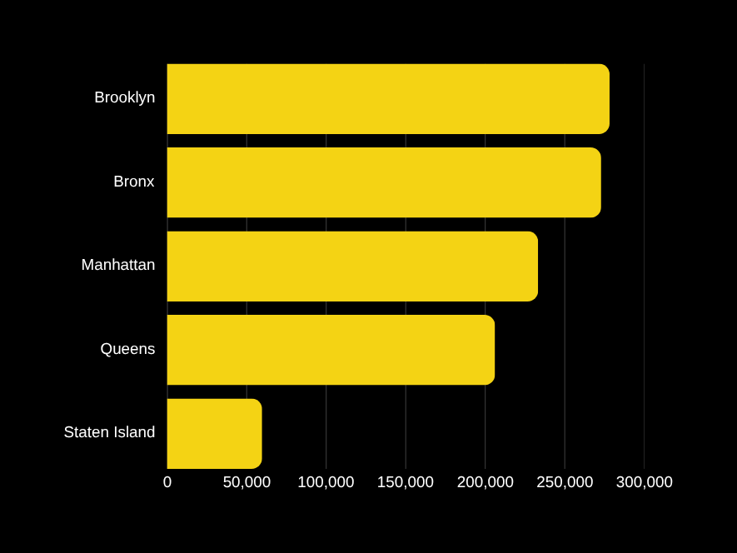
DELAY INCIDENTS BY BOROUGH
NYC SCHOOL BUS DATA ANALYSIS
278K
BROOKLYN INCIDENTS
Highest in NYC with 278,179 total delay incidents recorded.
278K
273K
233K
273K
BRONX INCIDENTS
206K
Second highest with 272,884 incidents across the borough.
60K

Slide 6


TOP BUS COMPANY
BROOKLYN DEEP DIVE
28.7k
INCIDENTS RECORDED
The leading bus company responsible for the most delays in Brooklyn.
25.8K
23.5K
BORO TRANSIT, INC.
17.7K
BORO TRANSIT, INC. accounts for 28,750 delay incidents in Brooklyn, representing the largest share of all bus delays in the borough. This significant volume highlights the need for targeted operational improvements and collaboration with this key transit provider.
16.9K

Slide 7
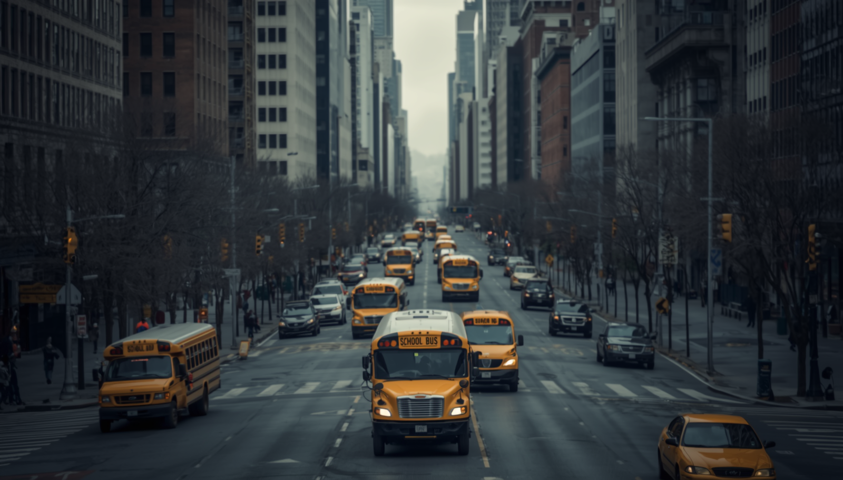
TOP REASONS FOR DELAYS IN BROOKLYN
NYC SCHOOL BUS DATA ANALYSIS
133,641
65K+
30K+
10K+
HEAVY TRAFFIC
OTHER REASONS
MECHANICAL
WEATHER/ACCIDENTS
Most common cause of delays across all Brooklyn incidents.
Includes problem runs, late returns, and miscellaneous issues.
Vehicle breakdowns and won't start issues combined.
Weather conditions, flat tires, and accident-related delays.

Slide 8
DELAY DURATION
BROOKLYN DELAY ANALYSIS
69,121
16-30 MINUTES
Most common delay duration - represents the largest share of all Brooklyn incidents
36,611
31-45 MINUTES
Second most frequent delay range - significant portion of extended delays

Slide 9

BROOKLYN DELAYS BY HOUR
NYC SCHOOL BUS DATA
99,578
90,871
7:00 AM PEAK HOUR
6:00 AM INCIDENTS
The morning rush hour at 7:00 AM experiences the highest number of delay incidents in Brooklyn. This peak aligns with school start times when traffic congestion is at its worst.
The 6:00 AM hour also shows significant delay activity as early morning bus routes begin. Together, these two morning hours account for the majority of Brooklyn's daily bus delays.

Slide 10
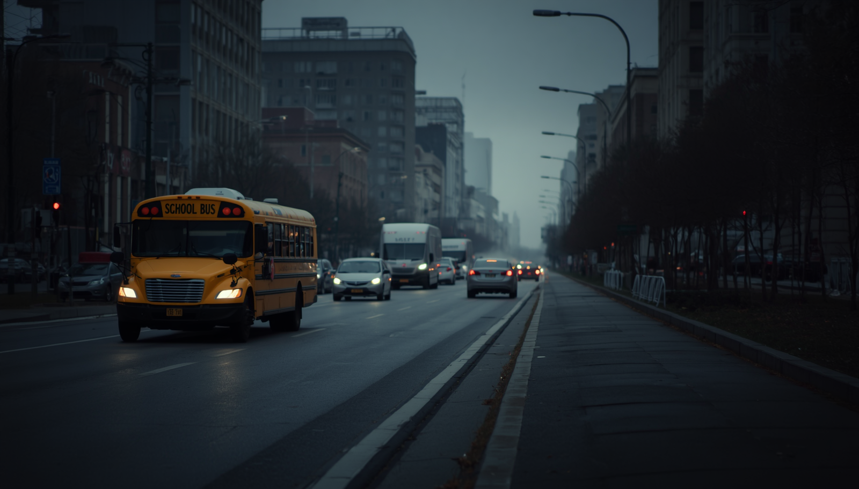

BROOKLYN DELAYS
BY DAY OF WEEK
NYC SCHOOL BUS DATA
57,2K
57,876
WEDNESDAY
55,7K
Highest delay day with 57,876 incidents - midweek experiences peak frequencies.
57,9K
54,3K
57,280
53K
MONDAY
Second highest with 57,280 incidents, closely following Wednesday's peak.

Slide 11


KEY INSIGHTS SUMMARY
NYC SCHOOL BUS DATA ANALYSIS
PRIMARY FINDINGS
Brooklyn leads all NYC boroughs in bus delay incidents with 278,179 total cases. Heavy traffic is the dominant cause, accounting for over 133,000 incidents in Brooklyn alone. BORO TRANSIT, INC. represents the largest share of delays with 28,750 incidents in the borough.
DELAY PATTERNS
Morning rush hour at 7 AM experiences the highest delay frequency with nearly 100,000 incidents recorded. Most delays last between 16-30 minutes, representing the most common duration category. Midweek days, particularly Wednesday, show slightly elevated delay rates compared to other weekdays.

Slide 12

IMPLICATIONS & NEXT STEPS
NYC SCHOOL BUS ANALYSIS
01
02
03
04
TRAFFIC MITIGATION
BORO TRANSIT
MONITOR ISSUES
MIDWEEK SCHEDULING
Focus on traffic mitigation strategies during morning rush hours in Brooklyn.
Collaborate with BORO TRANSIT, INC. for operational improvements.
Proactively monitor mechanical issues and weather impacts.
Consider targeted scheduling or routing changes midweek.

Slide 13

THANK YOU FOR YOUR TIME AND ATTENTION.
I’m especially grateful to
Prof. IMRAN KHAN
for the guidance and encouragement
that shaped this project.

Slide 14
Q&A SESSION
QUESTIONS?

Slide 15
01 – Traffic Mitigation It talks about paying closer attention to busy morning times in Brooklyn and finding ways to ease the traffic around school bus routes.
• 02 – Boro Transit It highlights working with BORO TRANSIT, INC. to make their operations smoother.
• 03 – Monitor Issues It focuses on keeping an eye on things like mechanical problems or weather that could slow buses down.
• 04 – Midweek Scheduling It suggests possibly adjusting routes or schedules in the middle of the week when things might shift.
Everything is set on a dark city street background, so the bright circles stand out clearly and make the steps easy to follow.

